Slide 1
Classroom learning dynamics using a cellular automata spatiotemporal model comparing peer instruction and traditional instruction
Instrumentation Physics Laboratory
AY 2024-2025 1st Sem Progress Report
November 4, 2024
Sy, Clarence Ioakim T.
BS4+ Applied Physics
Adviser: Dr. Johnrob Bantang
Complexity Science Group

Slide 2
Traditional instruction vs peer instruction
Traditional instruction | Peer instruction
The instructor delivers a lecture to the whole class for the duration of the class time. | Students are given the chance to learn from each other during class time after an initial lecture by the instructor.

Slide 3
Advantages of peer instruction (PI)
Improve students’ conceptual understanding and problem-solving skills compared to traditional instruction
Benefit groups even if no one in it initially knew the answer
Students with less background knowledge learn as much as students with more background knowledge (vs traditional instruction)

Slide 4
Research questions
How does the number of learned students develop over time?
Spatial position of high aptitude students in class
How does the positioning of learned students affect the learning rate of the class for peer instruction?
Learning rate
Traditional vs peer instruction
When is peer instruction better than traditional instruction?
Which factors lead to a difference in performance?

Slide 5
The classroom as a binary probabilistic CA model
The classroom is set to be a 2D square grid of varying lengths.
Students are either learned or not learned.
Simulations are initialized with 4 different seating arrangements (SA): inner corner, outer corner, center, random.
The simulation is considered done when all students are learned.

Slide 6
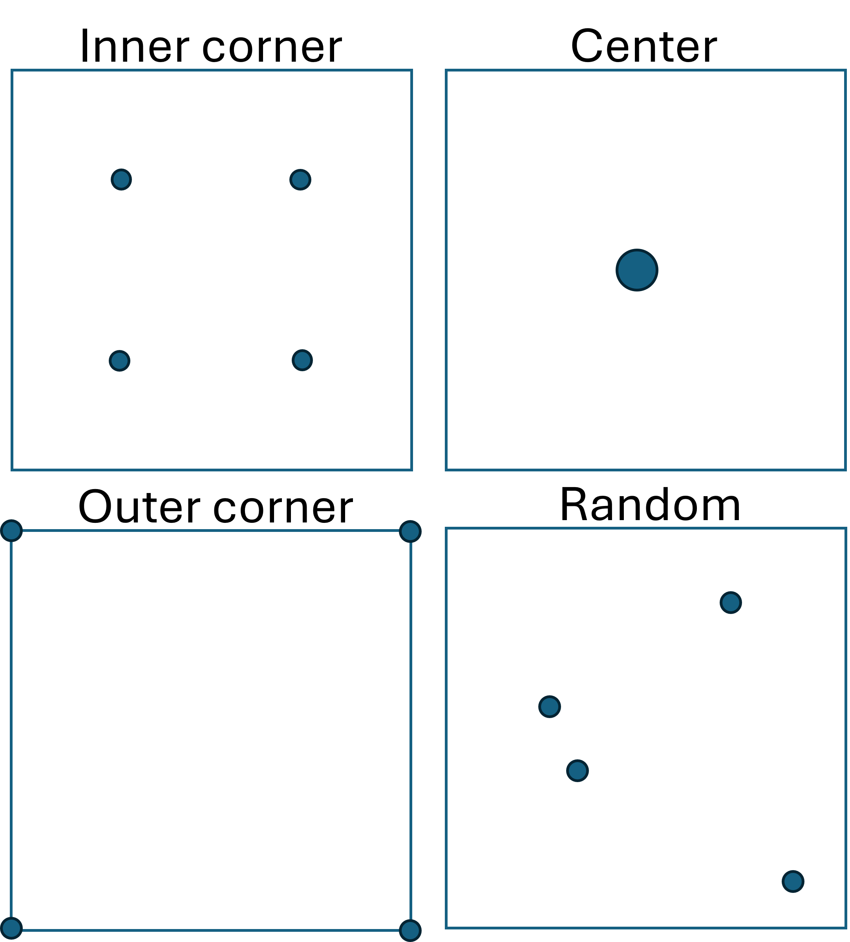
Different PI seating arrangements
- Circles indicate location of learned students

Slide 7
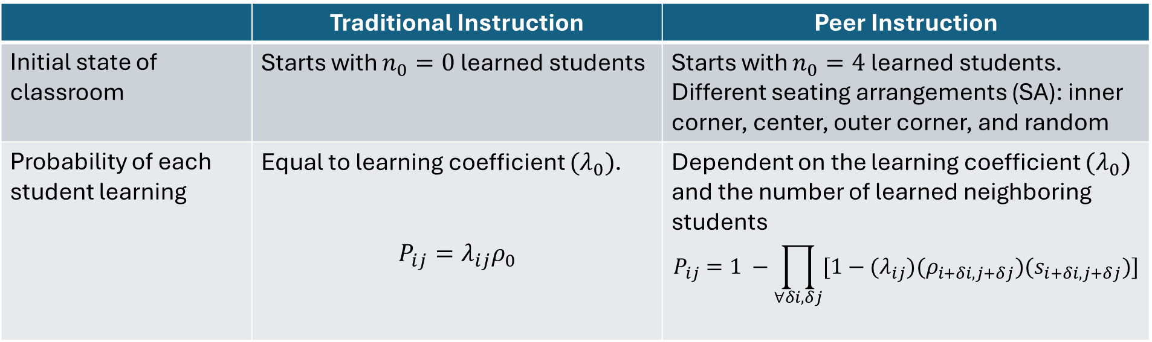
PCA rules for classroom simulation
 | Traditional Instruction | Peer Instruction
Initial state of classroom | Starts with $n_{0}=0$ learned students | Starts with $n_{0}=4$ learned students. Different seating arrangements (SA): inner corner, center, outer corner, and random
Probability of each student learning | Equal to learning coefficient $(λ_{0})$. $$P_{ij}=λ_{ij}ρ_{0}$$ | Dependent on the learning coefficient $(λ_{0})$ and the number of learned neighboring students $$P_{ij}=1 −\prod_{∀δi,δj}{[1−{(λ}_{ij})(ρ_{i+δi, j+δj})(s_{i+δi, j+δj})]}$$

Slide 8
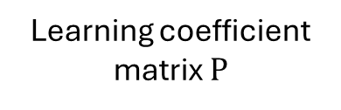
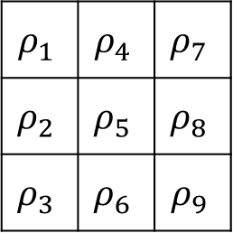
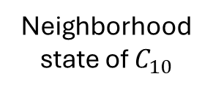
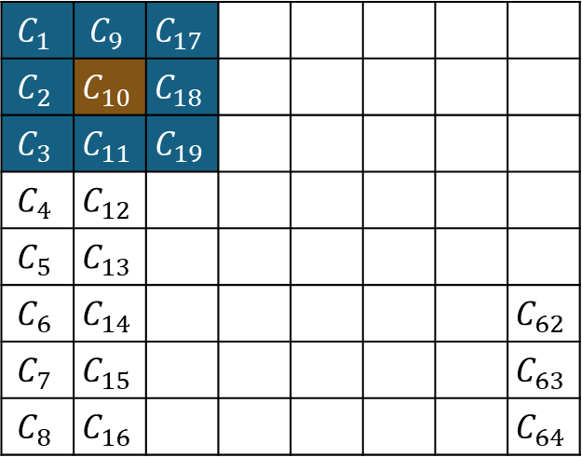

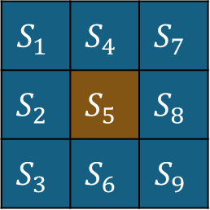
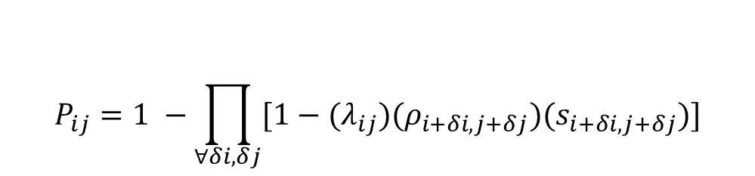
Determining learning probability per time step
$$S_{1}$$ | $$S_{4}$$ | $$S_{7}$$
$$S_{2}$$ | $$S_{5}$$ | $$S_{8}$$
$$S_{3}$$ | $$S_{6}$$ | $$S_{9}$$
$$ρ_{1}$$ | $$ρ_{4}$$ | $$ρ_{7}$$
$$ρ_{2}$$ | $$ρ_{5}$$ | $$ρ_{8}$$
$$ρ_{3}$$ | $$ρ_{6}$$ | $$ρ_{9}$$
$$C_{1}$$ | $$C_{9}$$ | $$C_{17}$$
$$C_{2}$$ | $$C_{10}$$ | $$C_{18}$$
$$C_{3}$$ | $$C_{11}$$ | $$C_{19}$$
$$C_{4}$$ | $$C_{12}$$
$$C_{5}$$ | $$C_{13}$$
$$C_{6}$$ | $$C_{14}$$ |  |  |  |  |  | $$C_{62}$$
$$C_{7}$$ | $$C_{15}$$ |  |  |  |  |  | $$C_{63}$$
$$C_{8}$$ | $$C_{16}$$ |  |  |  |  |  | $$C_{64}$$
$$⊙$$
Neighborhood state of $C_{10}$
Learning coefficient matrix $Ρ$
$$P_{ij}=1 −\prod_{∀δi,δj}{[1−{(λ}_{ij})(ρ_{i+δi, j+δj})(s_{i+δi, j+δj})]}$$
Learning probability:
Classroom represented as lattice of cells

Slide 9
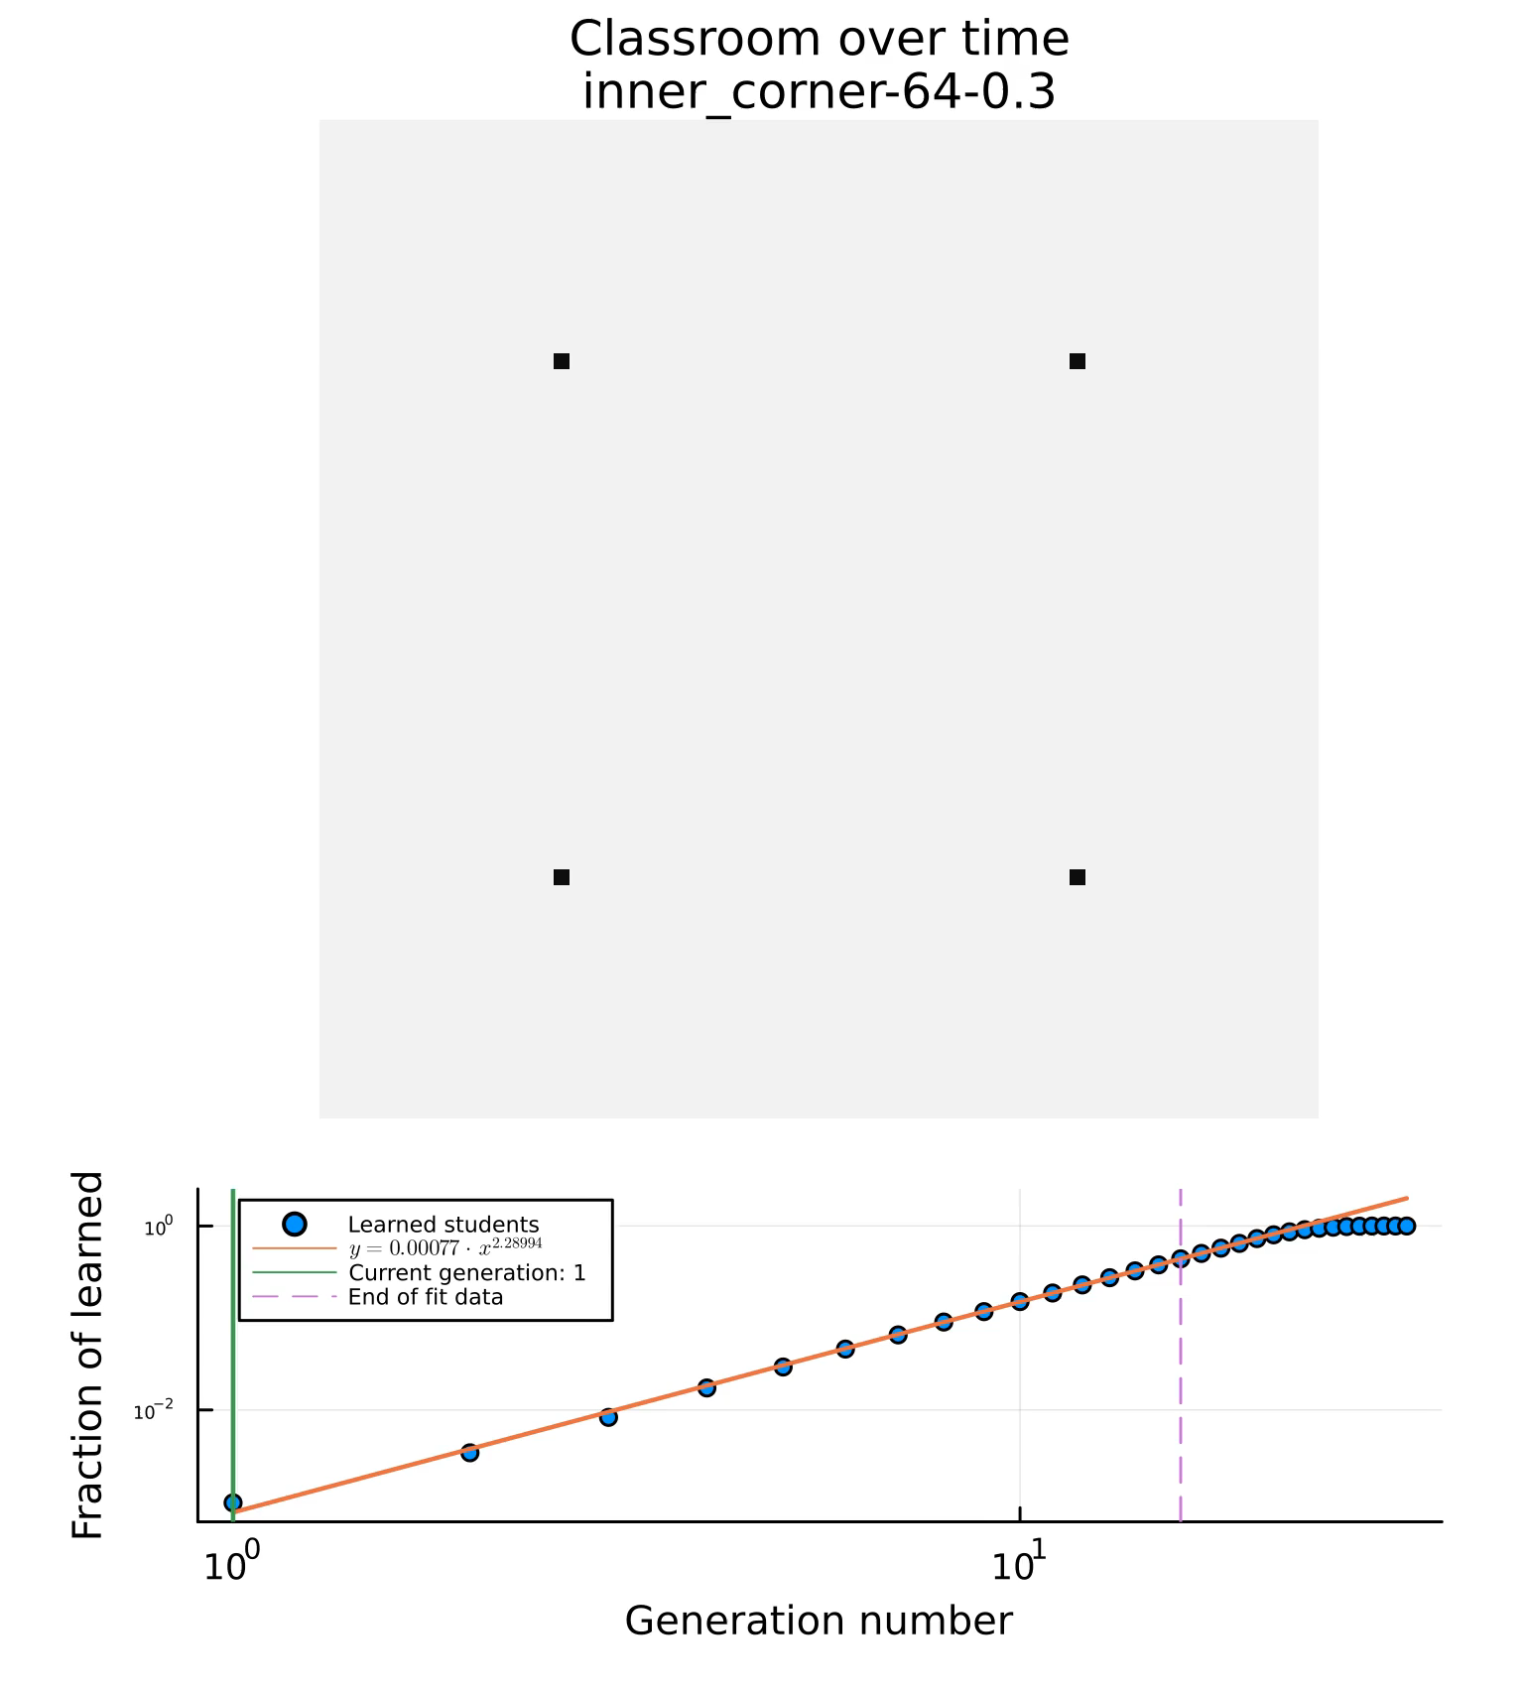
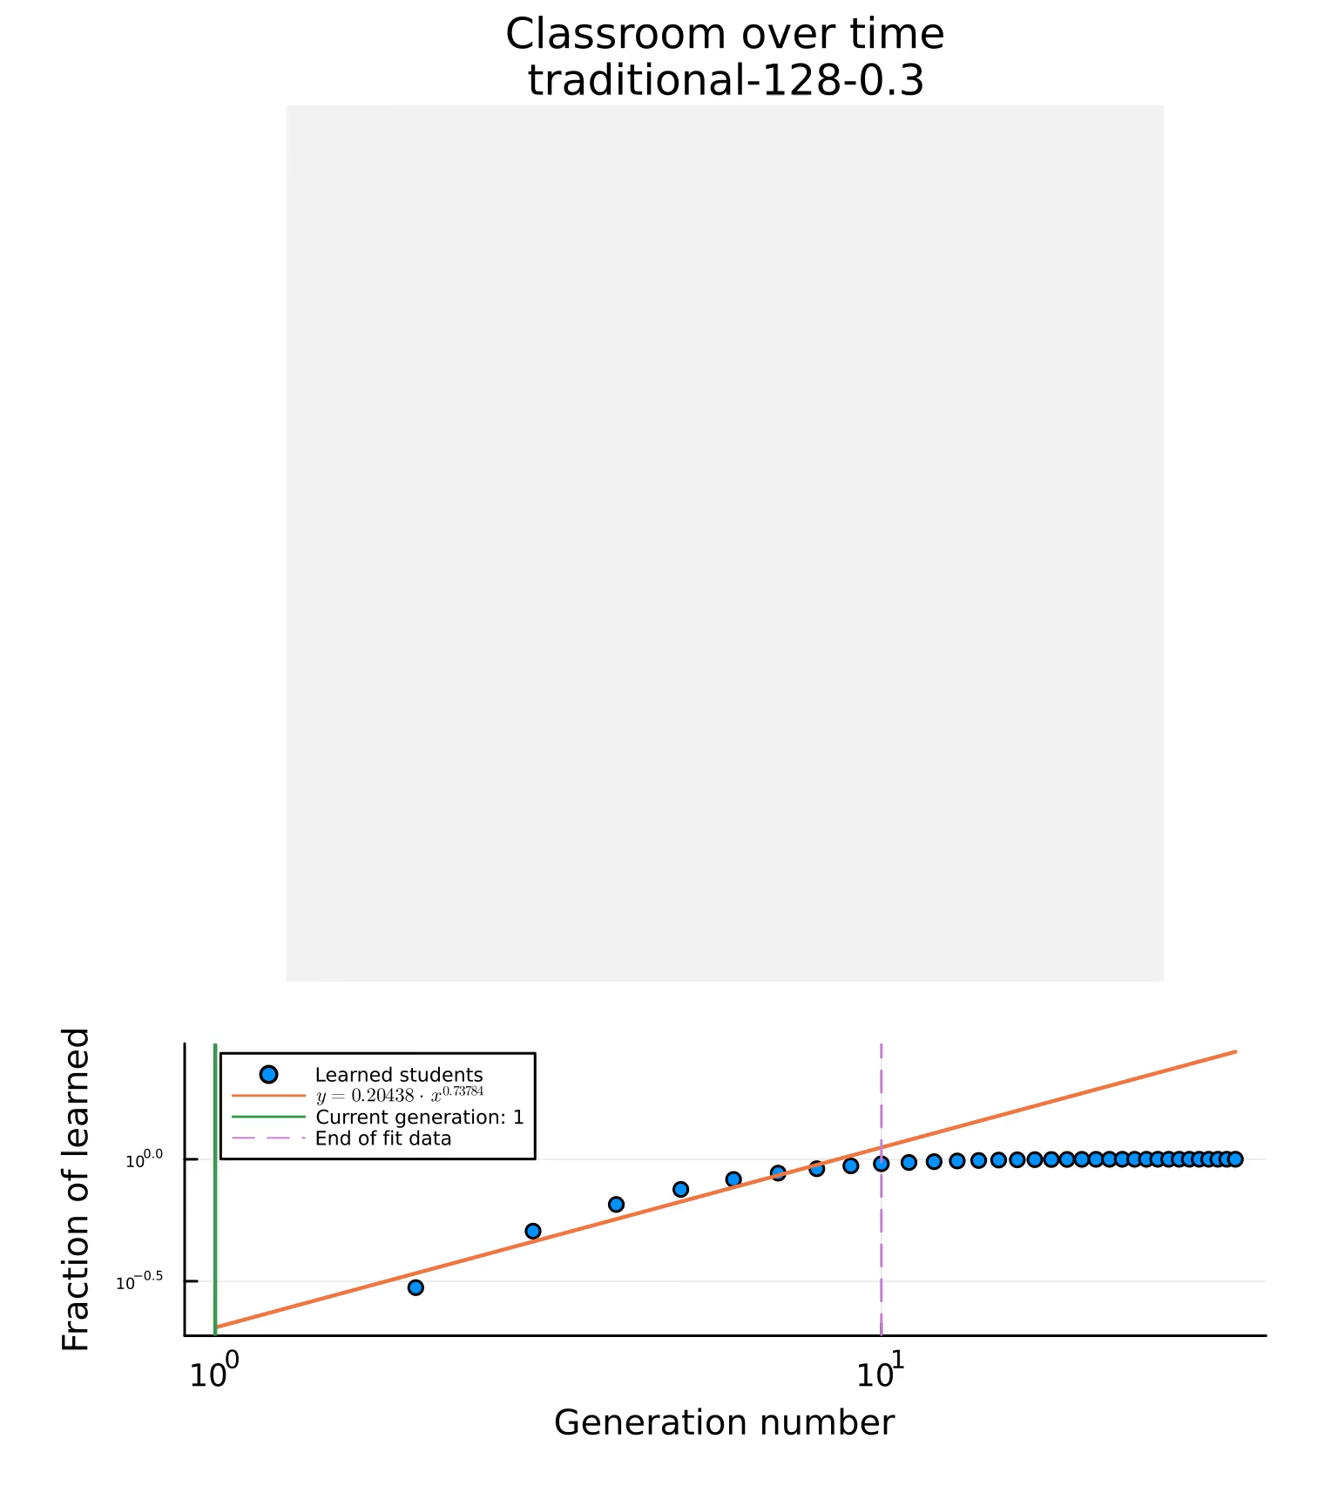
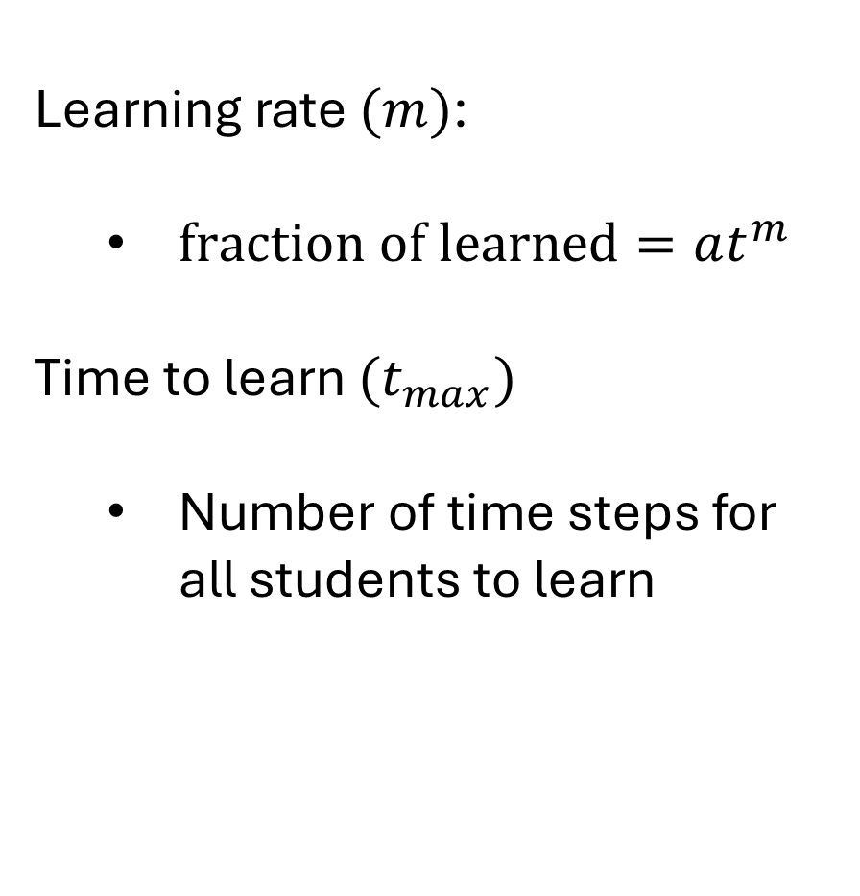
Learning rate $(m)$:
$fraction of learned=at^{m}$
Time to learn $(t_{max})$
Number of time steps for all students to learn
Time step
Time step

Slide 10
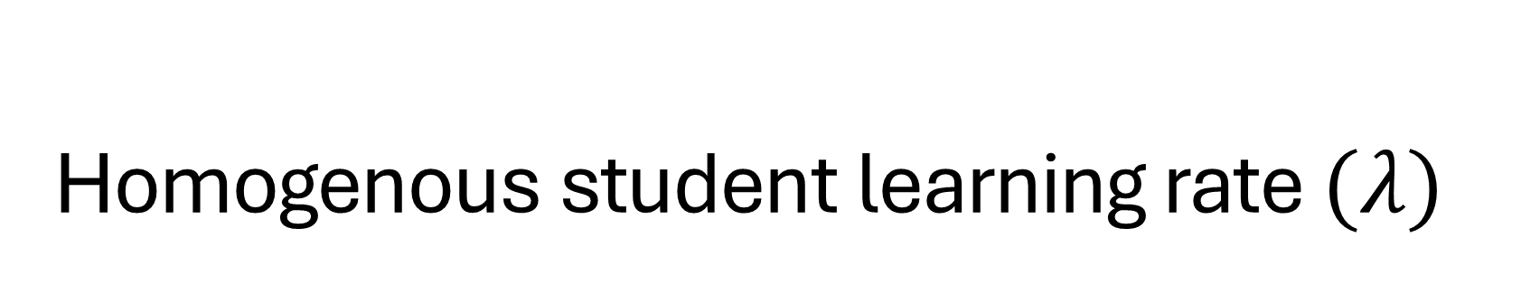
Homogenous student learning rate $(λ)$

Slide 11
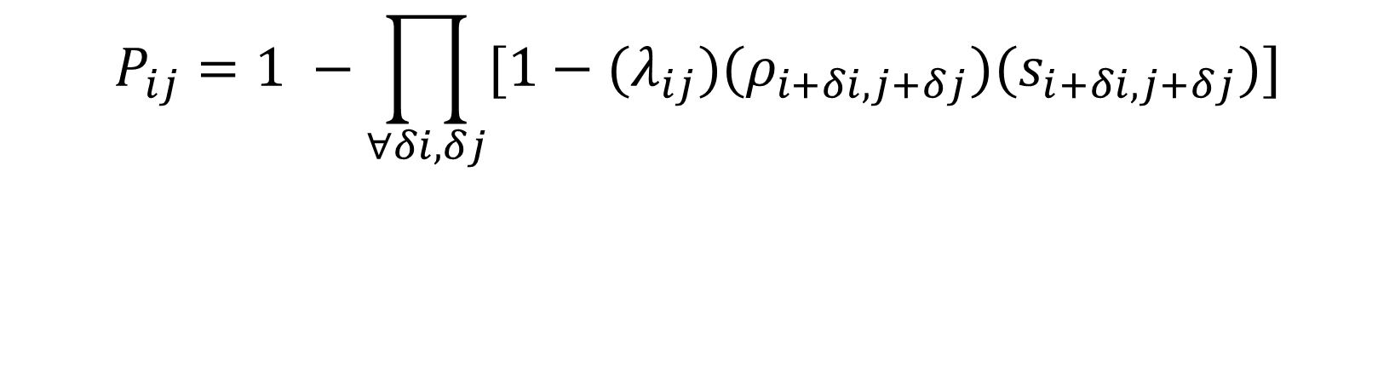
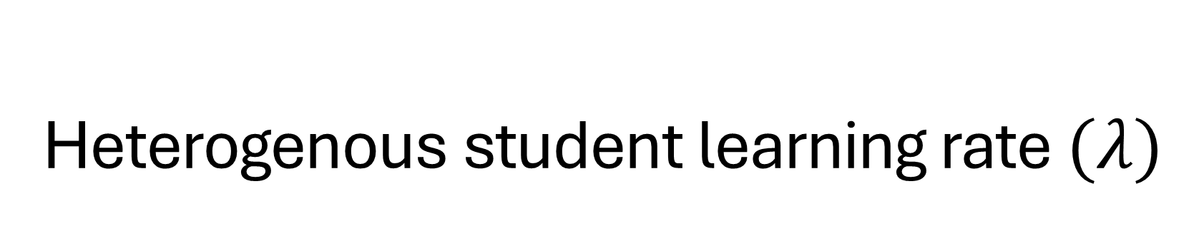
Heterogenous student learning rate $(λ)$
$$P_{ij}=1 −\prod_{∀δi,δj}{[1−{(λ}_{ij})(ρ_{i+δi, j+δj})(s_{i+δi, j+δj})]}$$
$λ_{ij}=λ_{0}$ $λ_{0}∈\{0.1, 0.2, …0.9, 1.0\}$

Slide 12
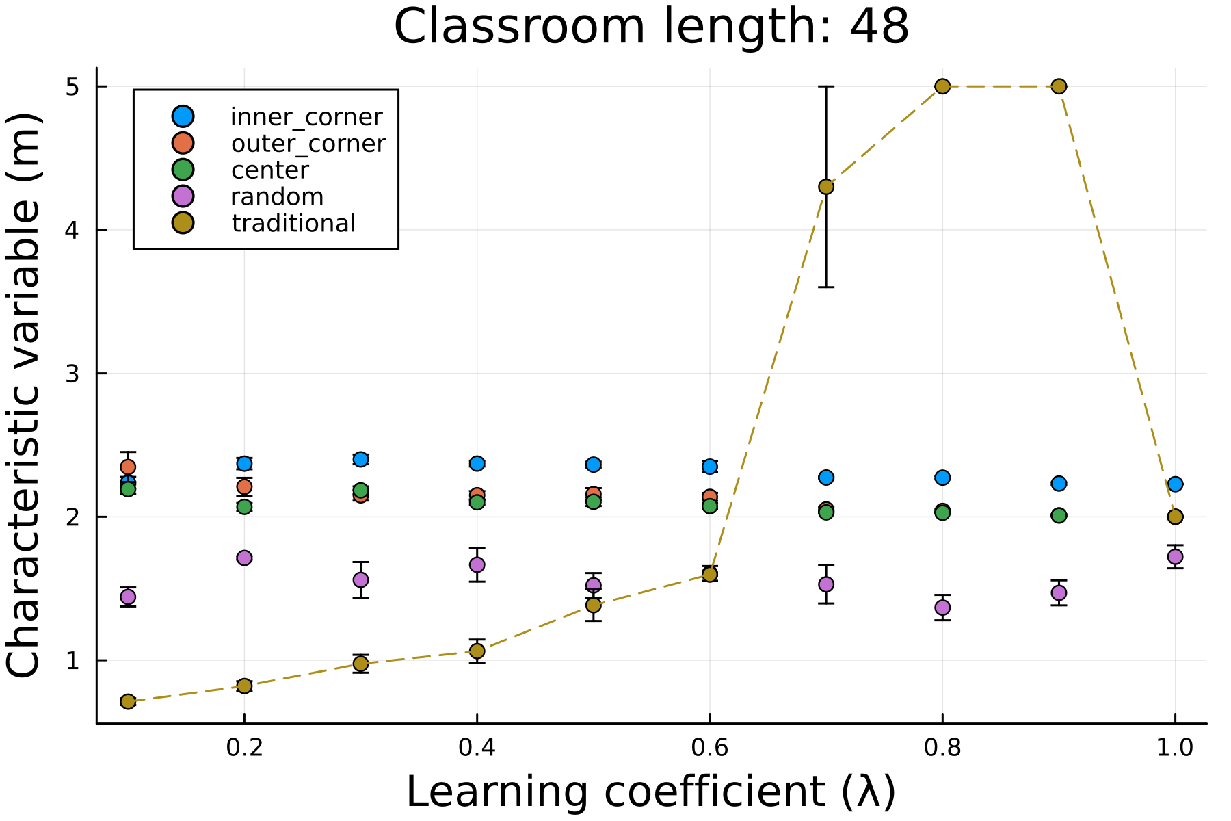
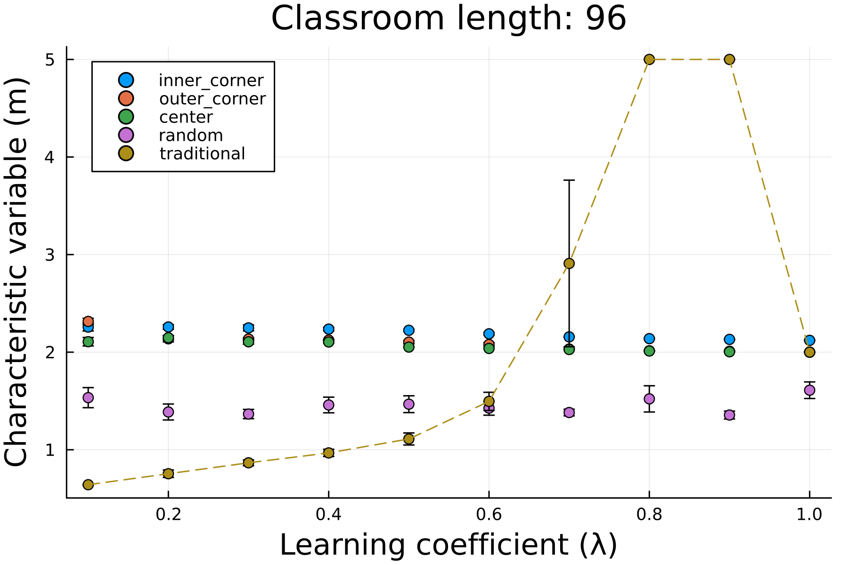

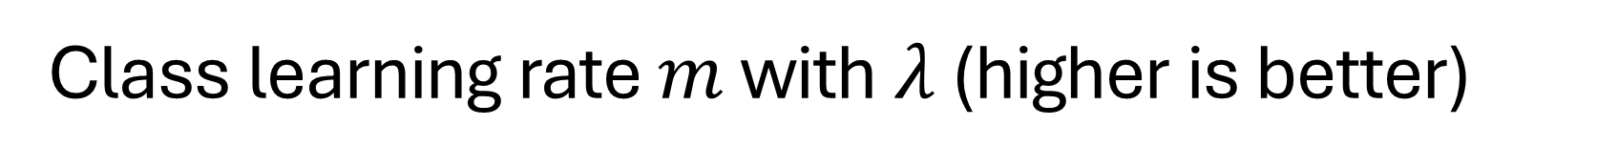

Class learning rate $m$ with $λ$ (higher is better)
Learning rate $(m)$
Learning rate $(m)$
For smaller learning coefficients $λ$, classrooms using PI have higher learning rates compared to their traditional counterparts

Slide 13
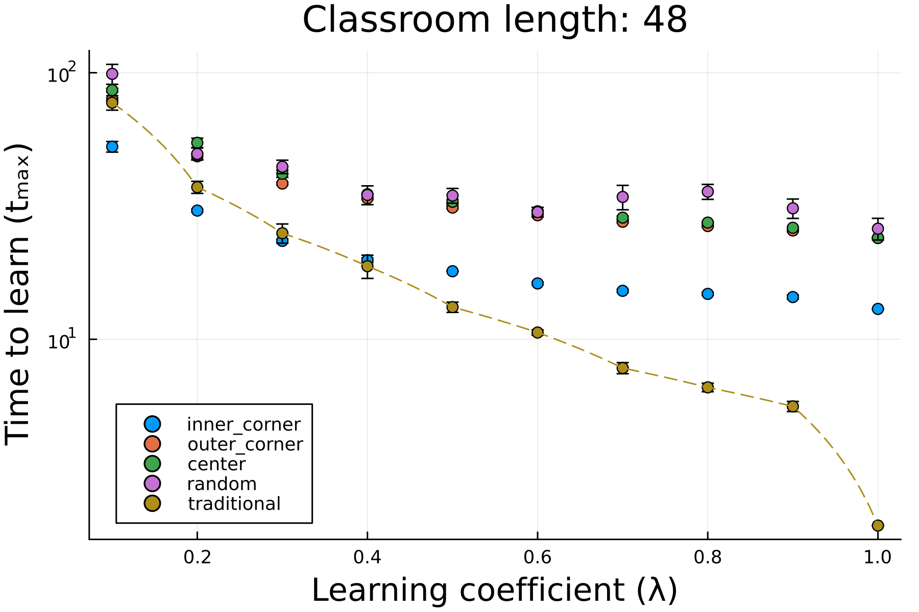
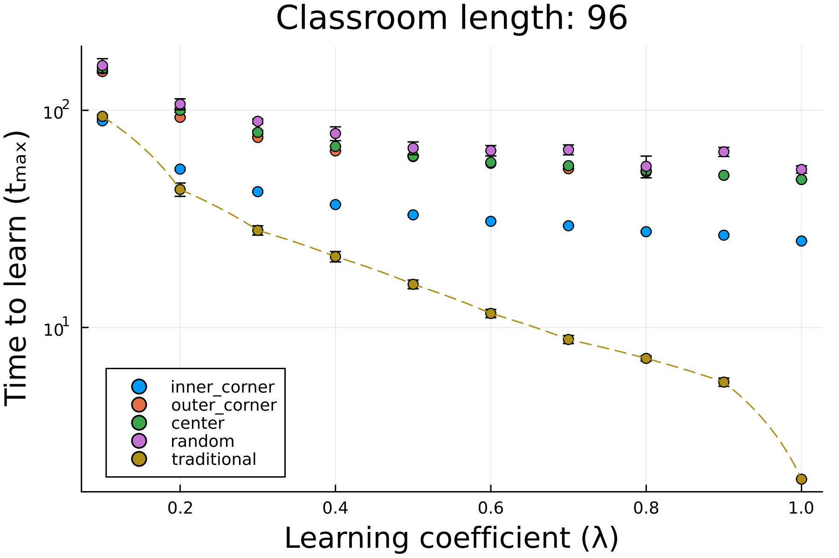
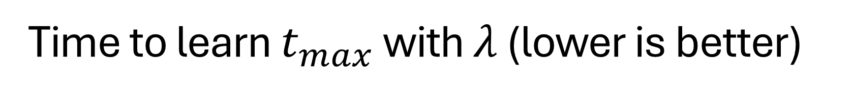
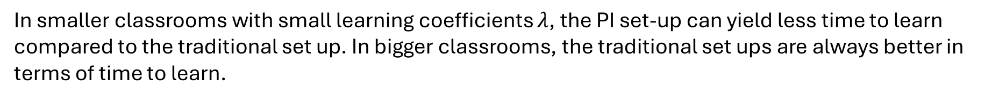
Time to learn $t_{max}$ with $λ$ (lower is better)
In smaller classrooms with small learning coefficients $λ$, the PI set-up can yield less time to learn compared to the traditional set up. In bigger classrooms, the traditional set ups are always better in terms of time to learn.

Slide 14
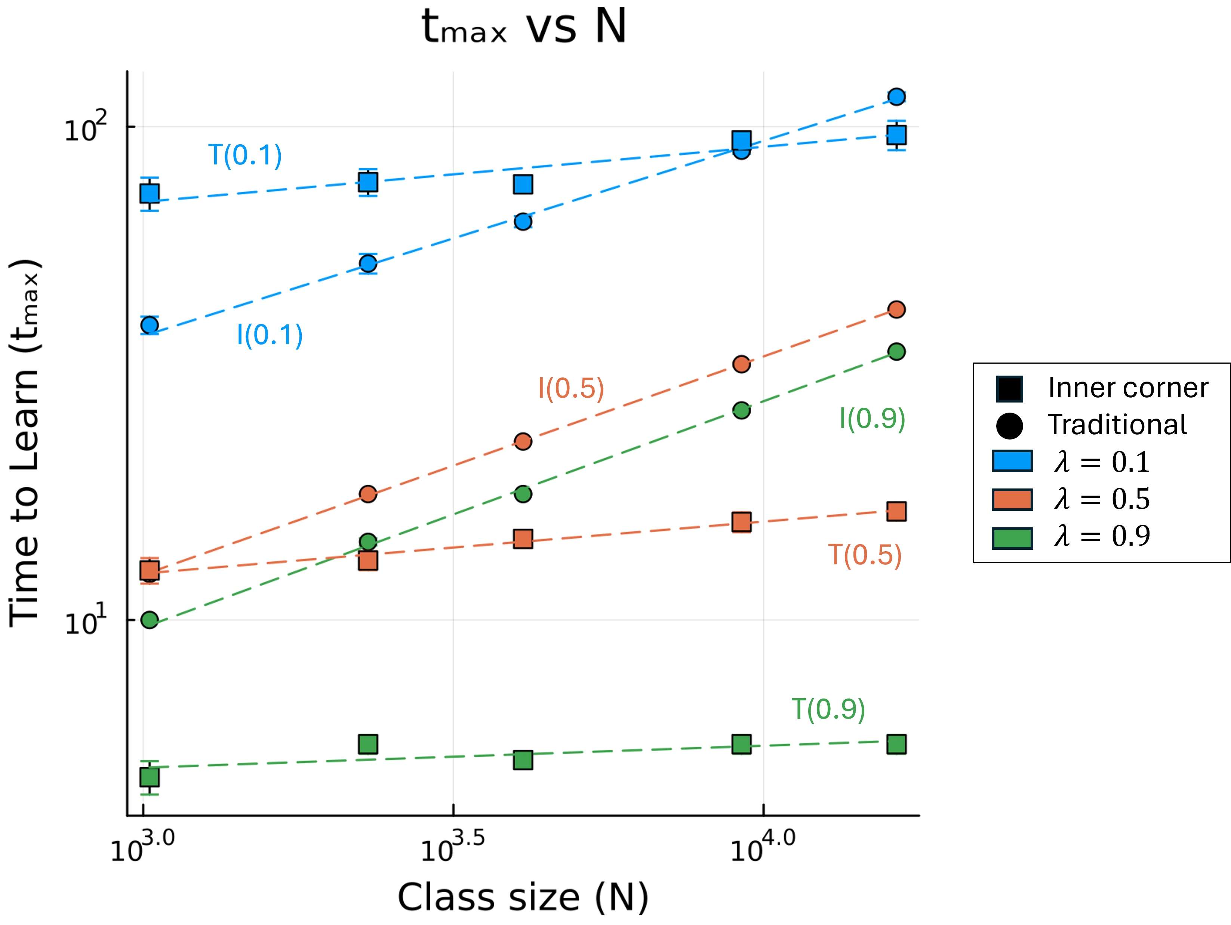
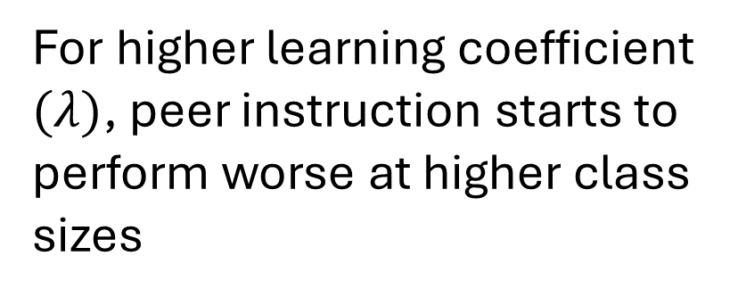
Time to learn $t_{max}$ with $N$ (PI vs. Traditional)
For higher learning coefficient $(λ)$, peer instruction starts to perform worse at higher class sizes
Traditional
PI (inner corner)

Slide 15
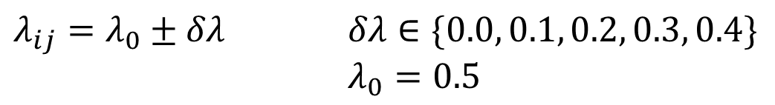
Heterogenous student learning rate $(λ)$
$$P_{ij}=1 −\prod_{∀δi,δj}{[1−{(λ}_{ij})(ρ_{i+δi, j+δj})(s_{i+δi, j+δj})]}$$
$λ_{ij}=λ_{0}±δλ$ $δλ∈\{0.0, 0.1, 0.2, 0.3, 0.4\}$
$λ_{0}=0.5$

Slide 16
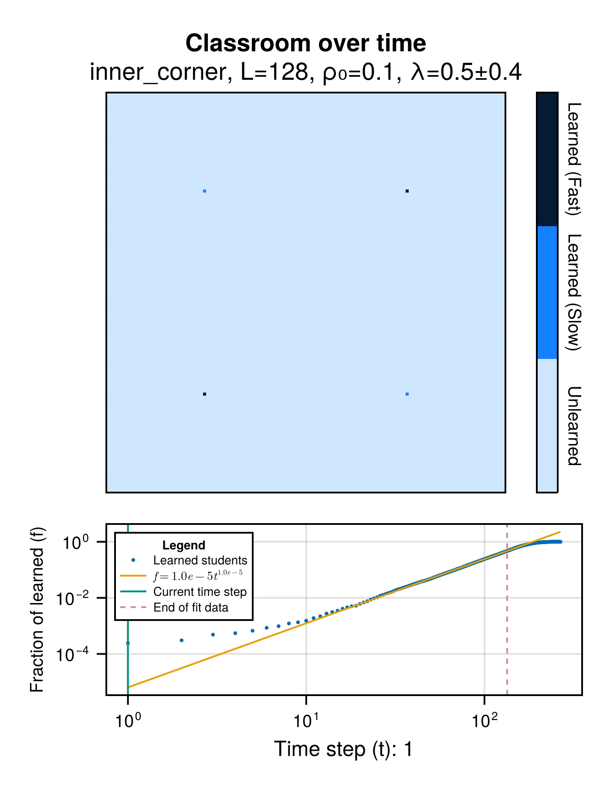
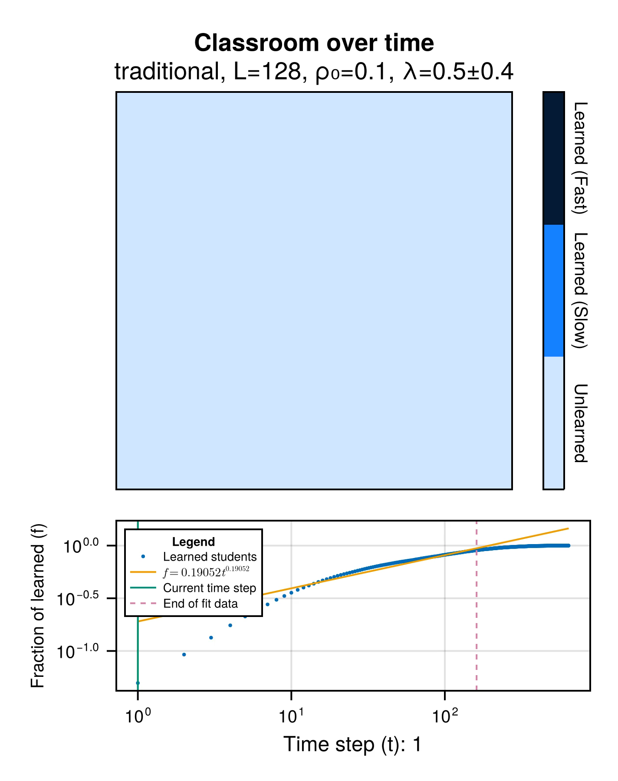

Slide 17
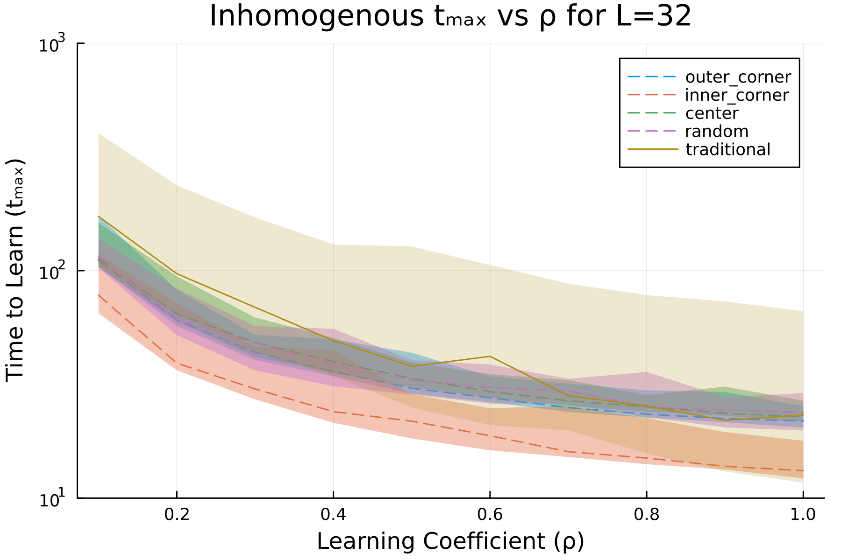
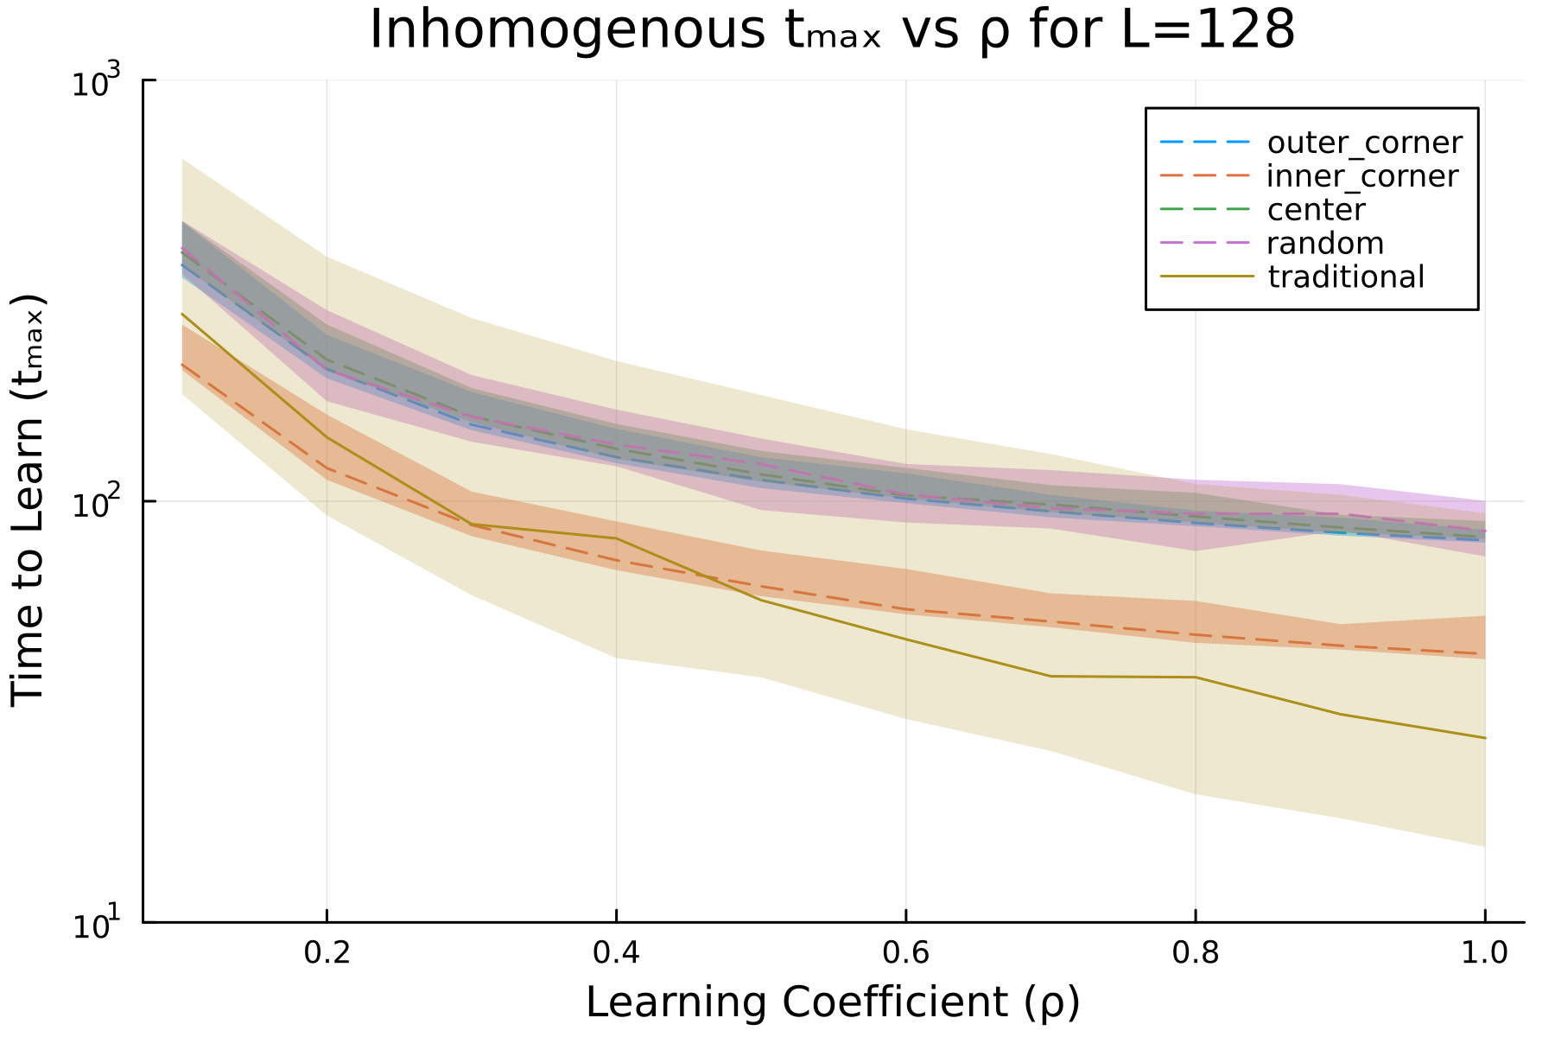
Time to learn ($t_{max}$) with learning coefficient ($ρ_{0}$)

Slide 18
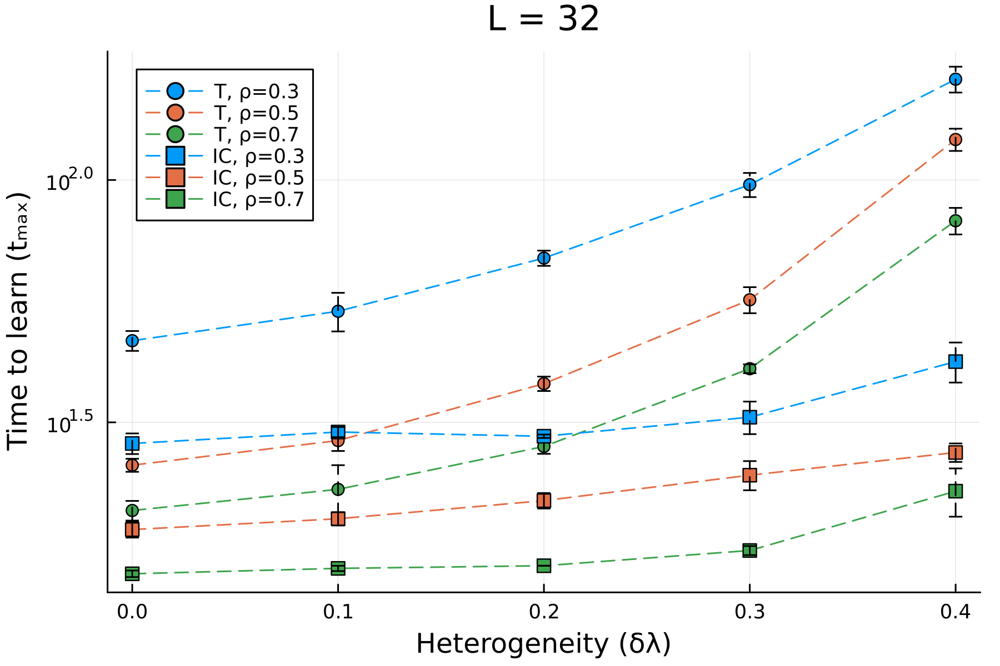
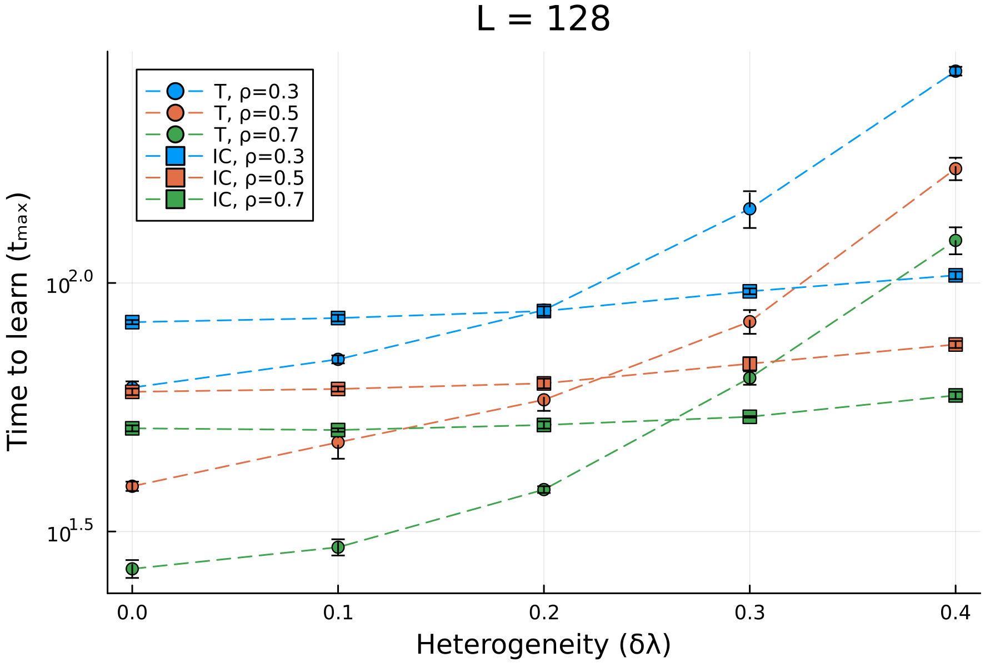
Time to learn ($t_{max}$) with learning coefficient ($ρ_{0}$)

Slide 19
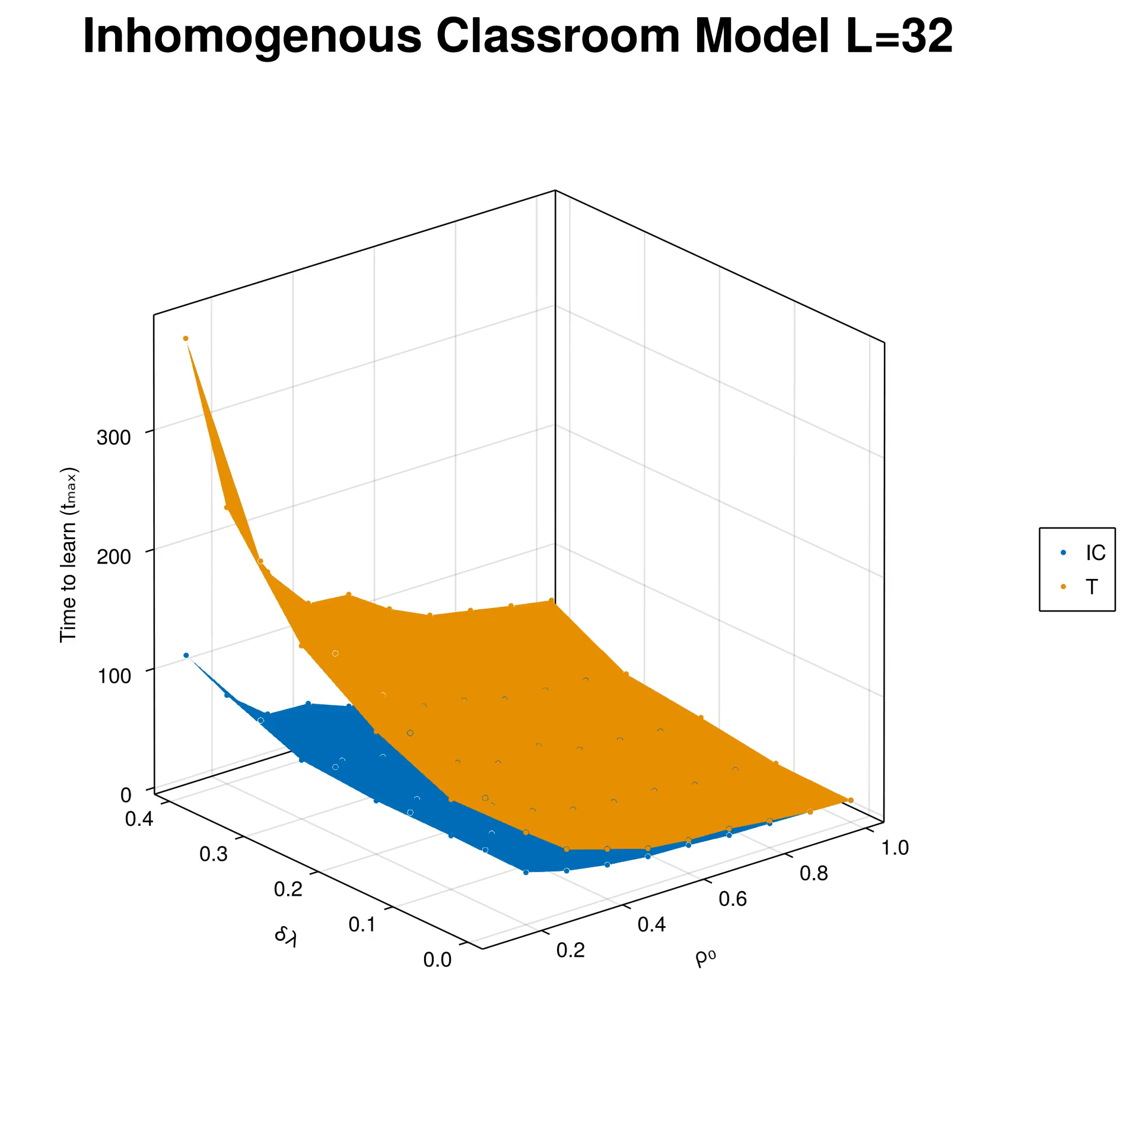
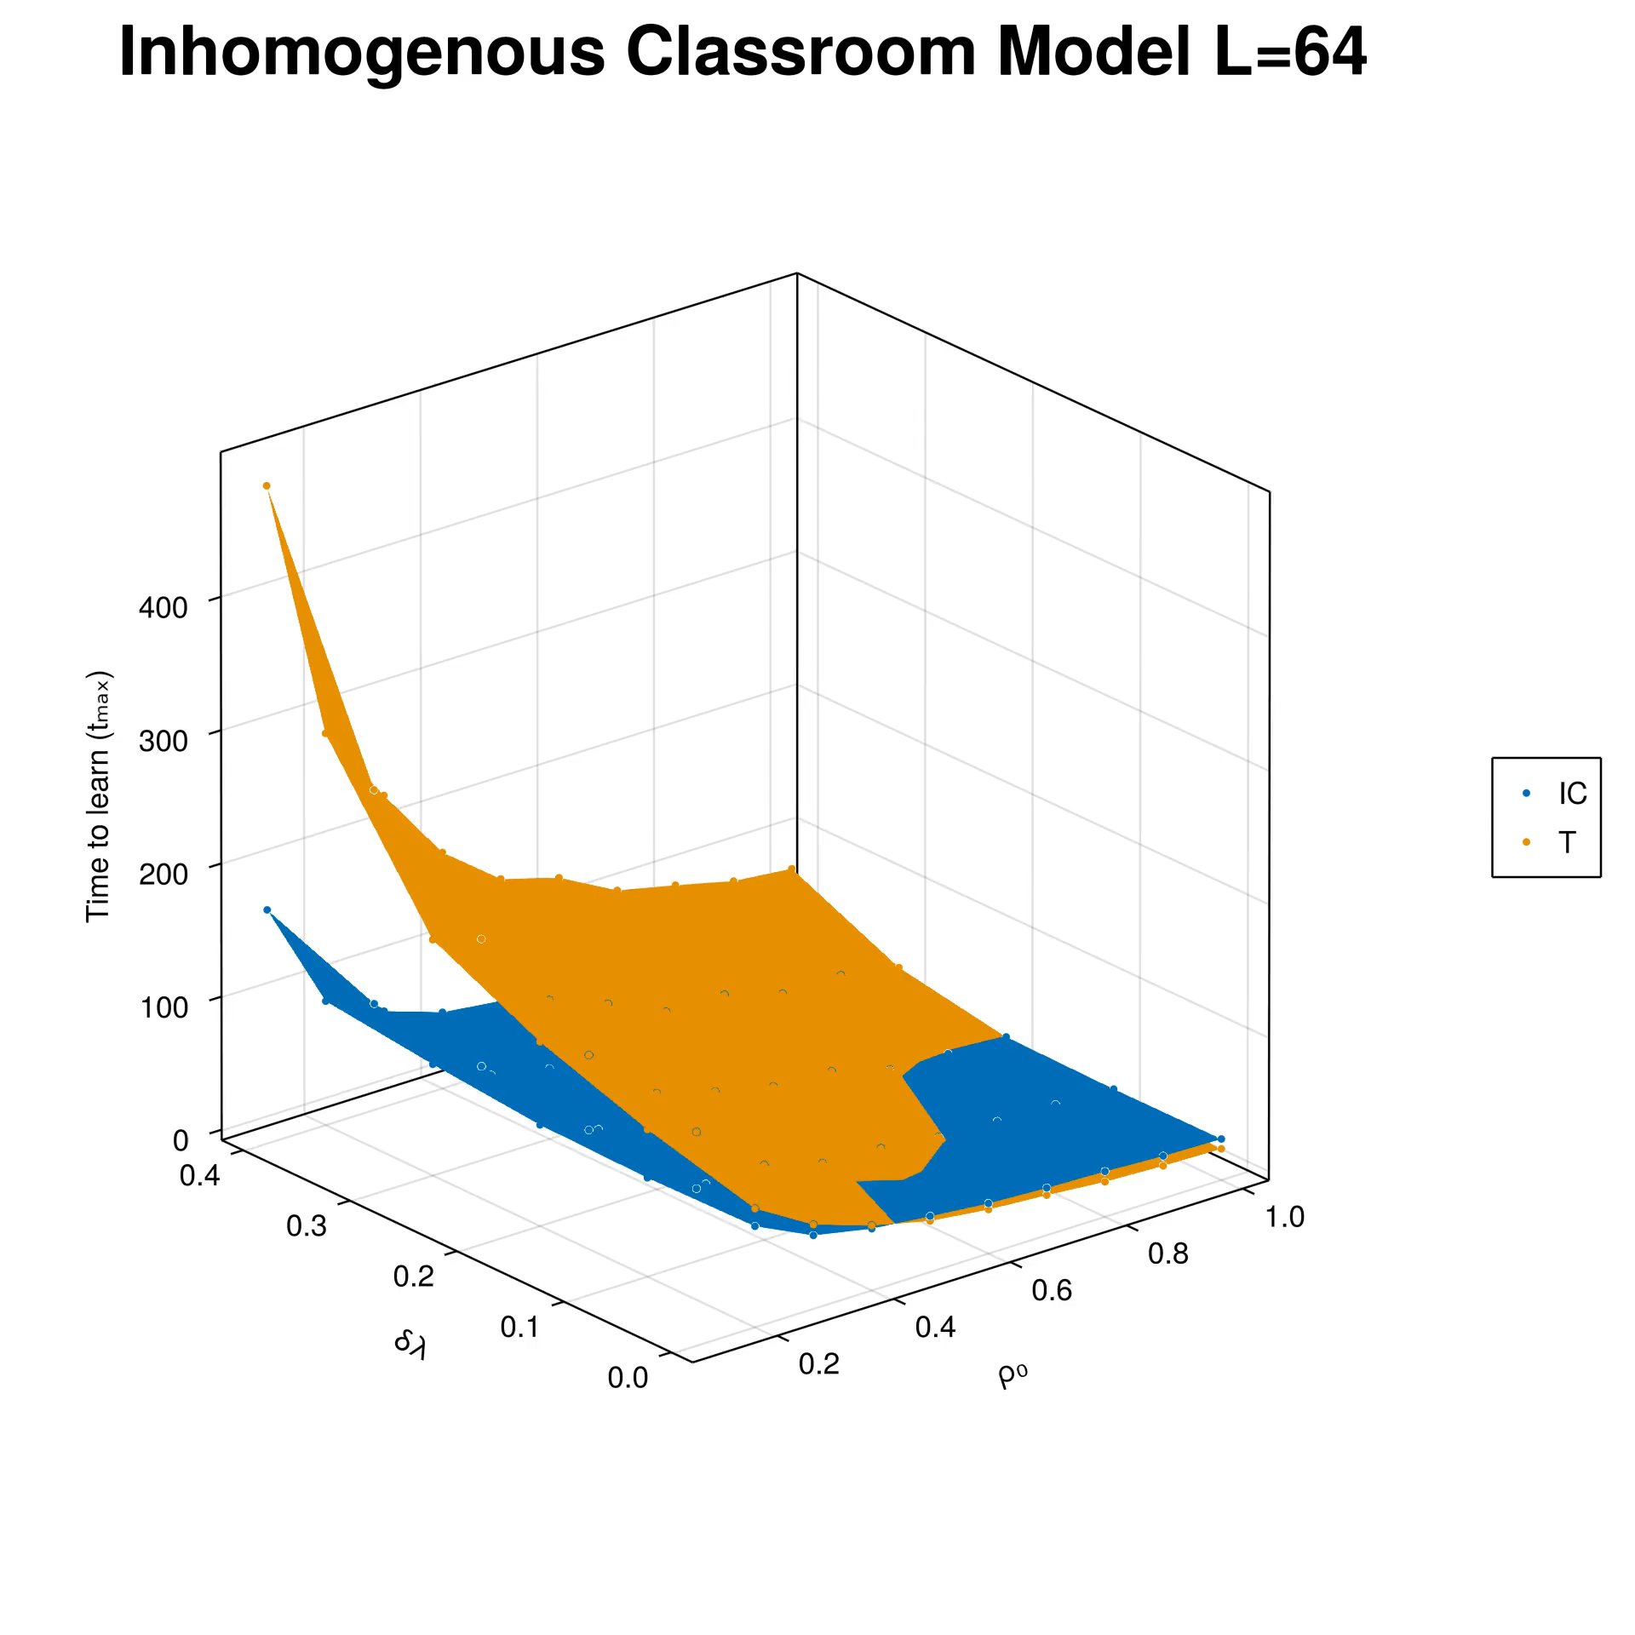
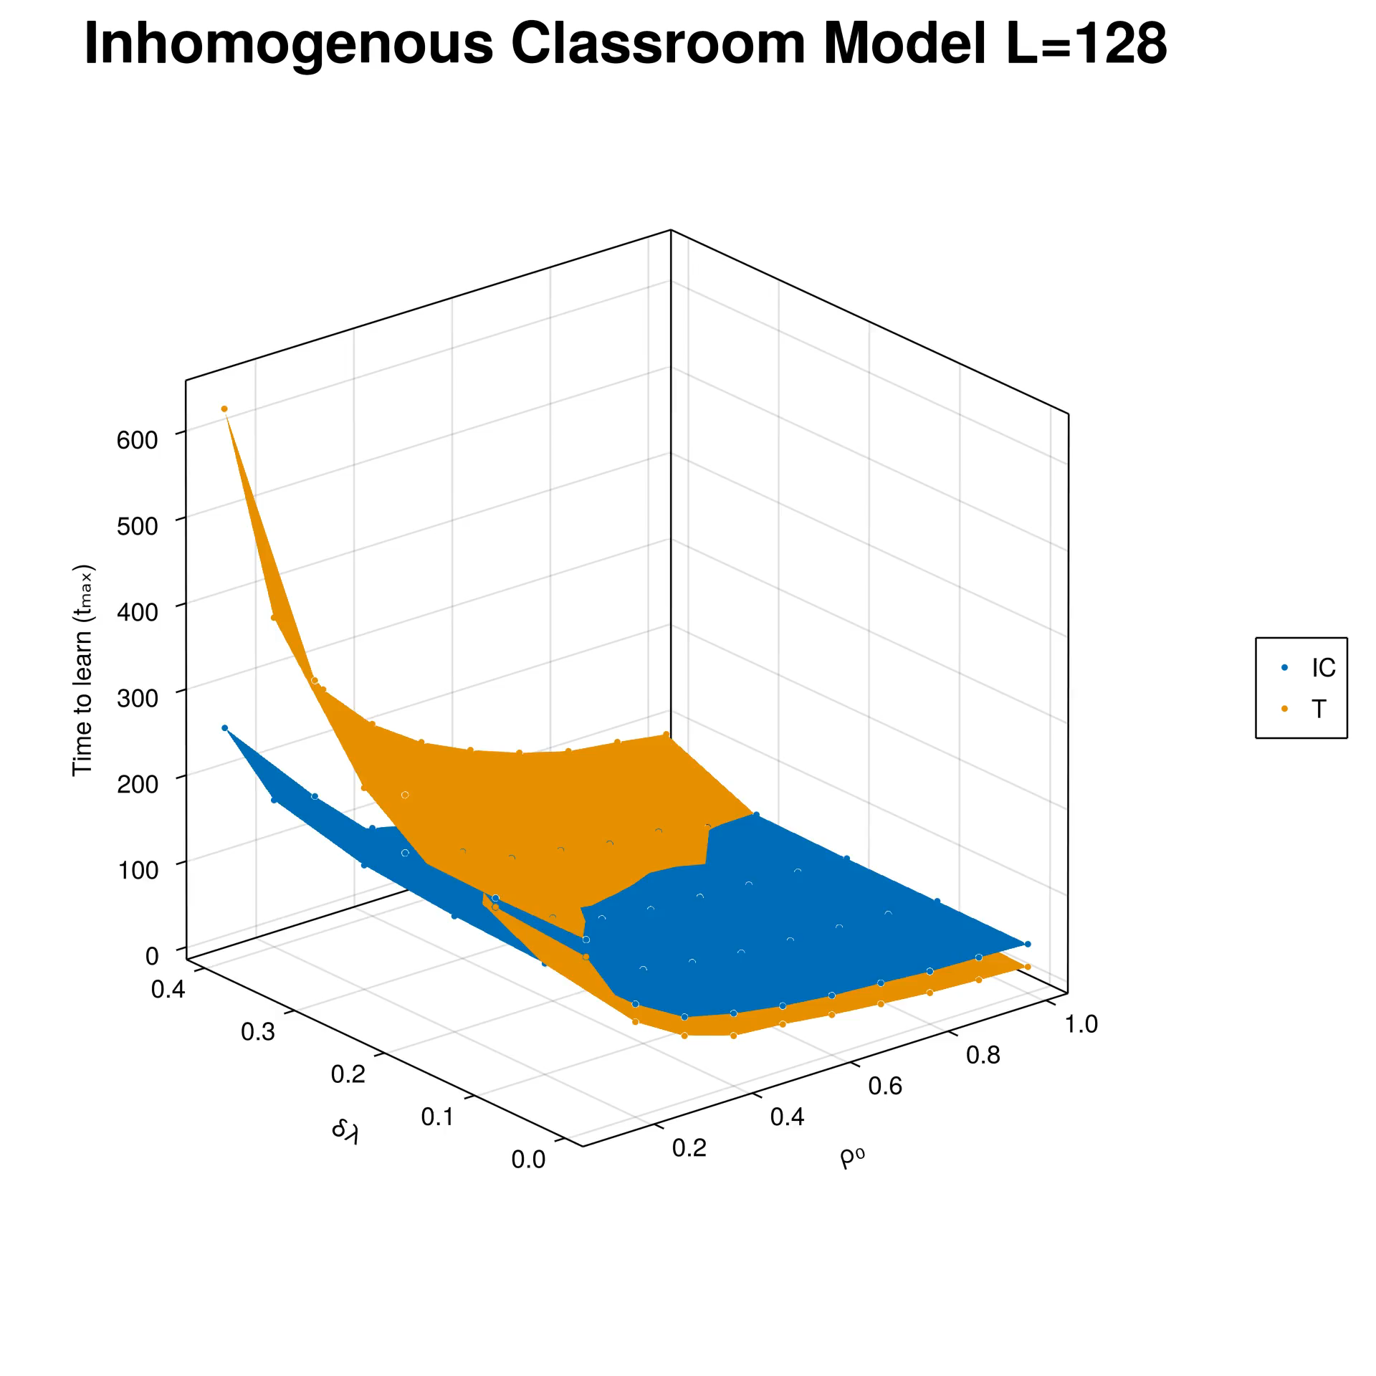
$t_{max}$ with learning coefficient ($ρ_{0}$) and heterogeneity ($δλ$)

Slide 20
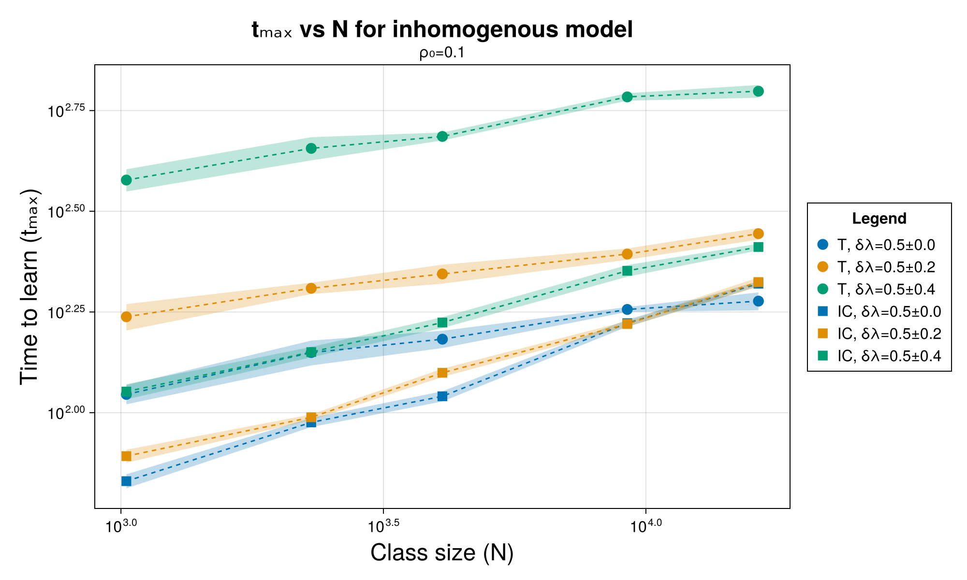
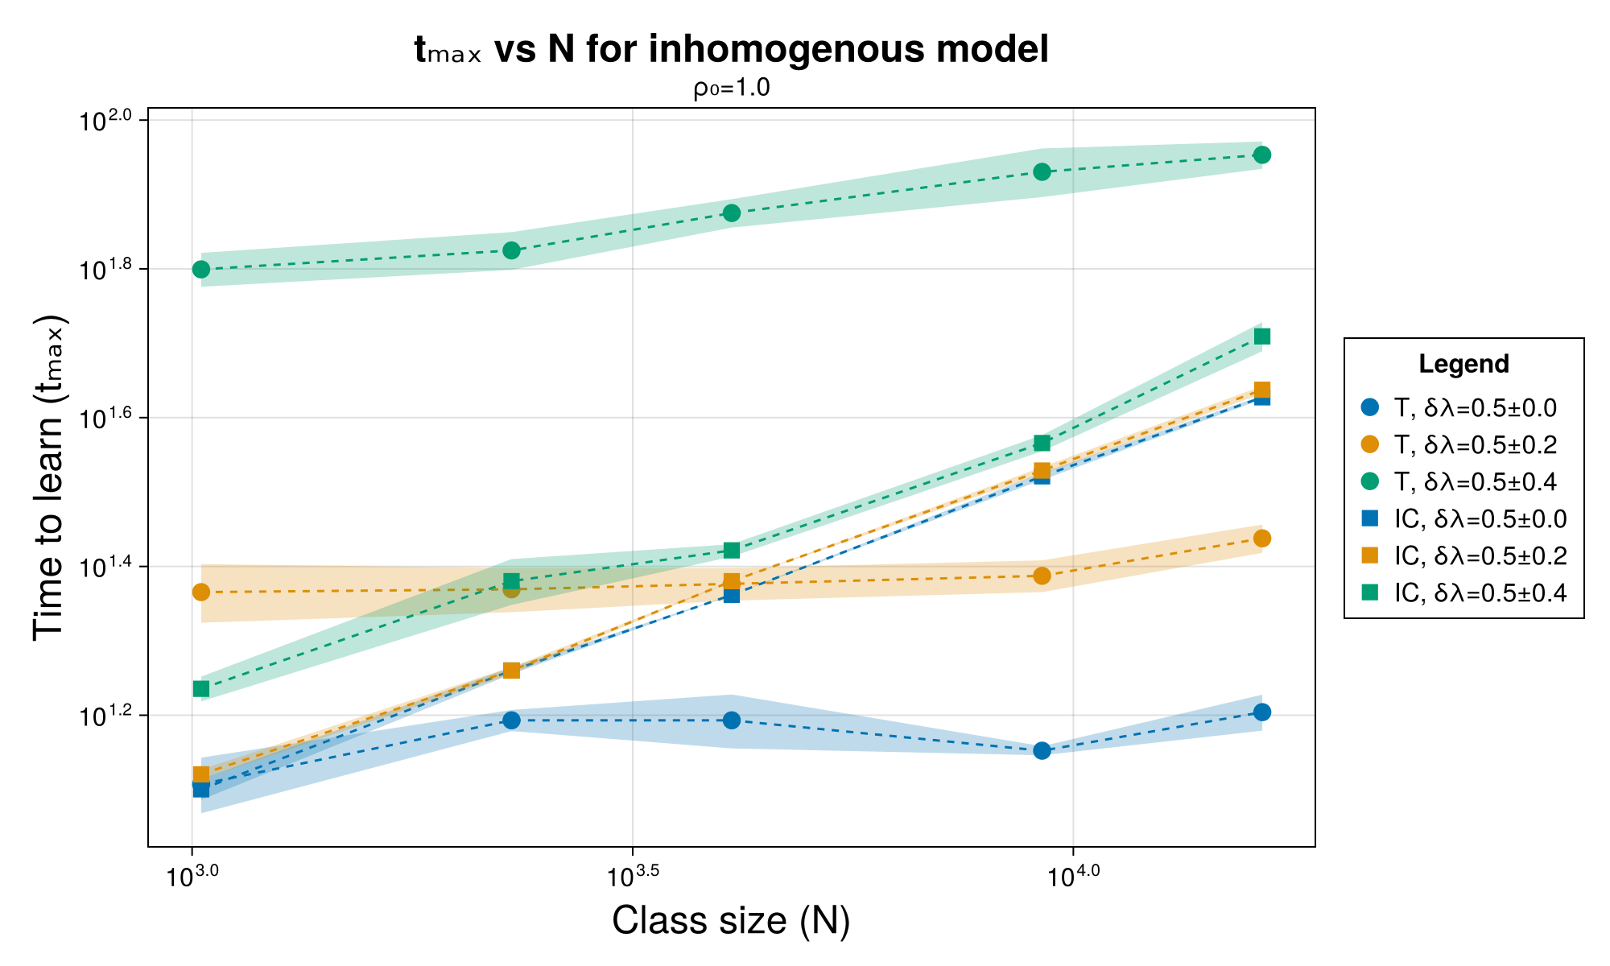

Time to learn ($t_{max}$) vs Class size ($N$)

Slide 21
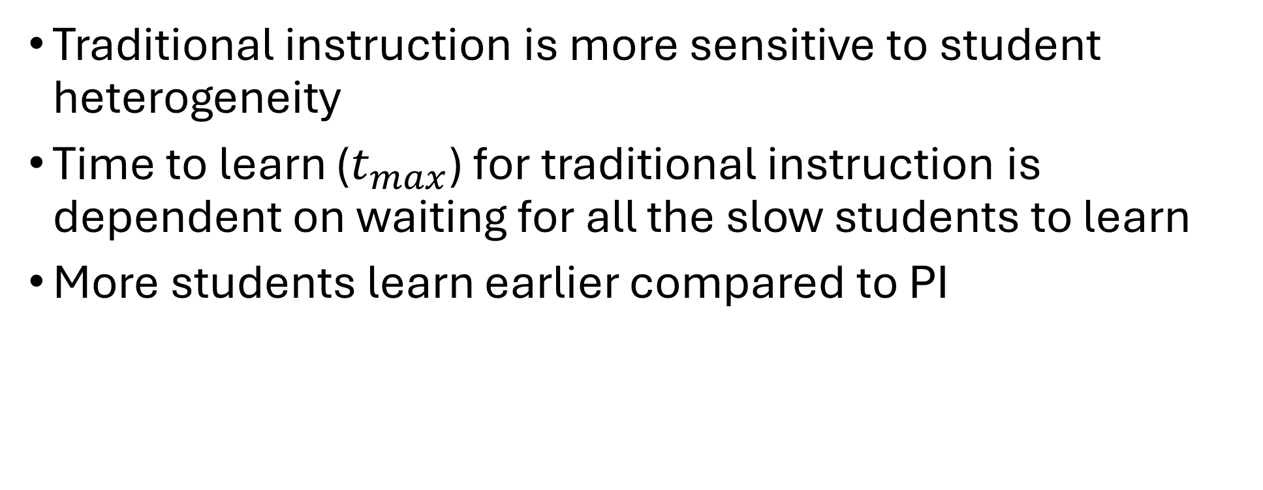
Conclusions
Traditional instruction is more sensitive to student heterogeneity
Time to learn ($t_{max}$) for traditional instruction is dependent on waiting for all the slow students to learn
More students learn earlier compared to PI

Slide 22
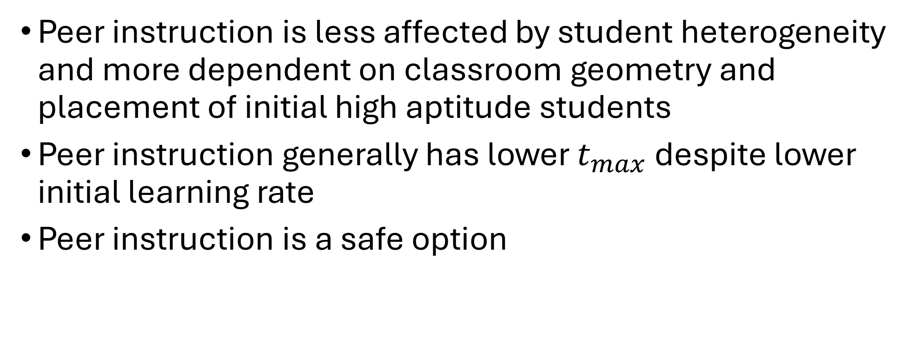
Conclusions
Peer instruction is less affected by student heterogeneity and more dependent on classroom geometry and placement of initial high aptitude students
Peer instruction generally has lower $t_{max}$ despite lower initial learning rate
Peer instruction is a safe option
Notes:
Re: safe option - the performance advantage of traditional over PI is not as pronounced as the performance advantage of PI over traditional.

Slide 23
To do
Finish manuscript
Poster and video abstract
Defend thesis
SPP2025?

